Slide 1
CS 4530: Fundamentals of Software Engineering Module 10.3: Distributing Processing
Adeel Bhutta, Joydeep Mitra, Mitch Wand
Khoury College of Computer Sciences
© 2025 Released under the CC BY-SA license

Slide 2
Learning Goals for this Lesson
By the end of this lesson, you should be able to…
Recognize a few common software architectures
Discuss some of the tradeoffs of scalability, performance, and fault tolerance between these architectures

Slide 3

Distributed Software Architectures
Goal: abstract details away into reusable components
Enables exploration of design alternatives
Allows for analysis of high-level design before implementation
Match system requirements to quality attributes of common architectural patterns
Notes:
In today’s lecture, we will discuss common distributed systems architectures.
(Read slide)
In the same way that object oriented design patterns let us reason about trade-offs in common problems, software architectures let us reason about tradeoffs to common problems, but at a much larger scale.
For example, consider the layout of buildings on campus: determining where to put what building and how people flow between them is an important step of design.
This is design at what we called the Structural Scale, back in Module 04.

Slide 4
Review: Challenges of Distributed Systems
More machines mean more links that can fail
Networks introduce delays
Networks still fail, intermittently and for long periods
Networks rely on fallible external administrators
Sequential consistency is impossible
Notes:
<READ SLIDE>
These are the things that our software architectures need to cope with.

Slide 5
Questions to Ask About Distributed Architectures?
How many individual pieces can fail before the whole fails? Who is responsible for those pieces?
How complicated is it…
To operate?
To debug?
To set up a development environment?
How much CPU/RAM/bandwidth is needed to run it? (in total and per-node)
What is the strategy for increasing capacity?
Notes:
Each of those challenges has an implication on our system design. We can pick different high-level designs that will make different tradeoffs between the different challenges.
Here are a few framing questions that you should consider when thinking about how to design a distributed system. By choosing different distributed architectures, we can create systems that will have predictable answers to these questions.
<read slide>

Slide 6
A brief survey of distributed architectures
Monolithic server
Tiered architectures
Pipeline architectures
Microservice architectures
Notes:
In the remainder of this module, we will consider 3 kinds of architectures that might be used in a distributed system, and discuss their advantages and disadvantages.

Slide 7
1. The Monolith Architecture Relies on a Single Server
Simplest answer to consistency problem: have only one server, one source of truth
Still “distributed” in that we have many clients
Sacrifices:
Scalability
Performance
Fault tolerance
Server
Client
Client
Client
Client
Client
Notes:
While most distributed systems involve multiple “servers” coordinating to act as one, it is also worthwhile to consider the case of a single server interacting with multiple clients.
<READ SLIDE>
When considering the system as a whole: the clients *and* the server, there is still some coordination that occurs to implement the system’s goals. We will start with discussing this “monolithic” application as a starting point for examining other common distributed systems architectures.

Slide 8
Monolithic Architectures Struggle to Scale
Scalability - How to go from 10 to 100 to 1,000 clients?
Performance - How to access 100’s of GB of data concurrently?
Fault tolerance - What if server crashes?
Server
Client
Client
Client
Client
Client
Notes:
The performance of the monolith is limited by the performance of that single node and its network links. If, in this figure, we have 5 clients all trying to read 100GB files concurrently, they will be limited by the total throughput of this one server.
To scale a monolith, our only option is to replace our server with a bigger server. Eventually, we will reach a limit of the performance of a single server.
Also, the monolithic architecture is weak on fault-tolerance: If the single server goes down, the whole system goes down.
<Ask students:> Where do you think this architecture falls on the “how hard to operate” or “how hard to set up a development environment” scale?

Slide 9
Replication Alone is Not The Answer
Constraints:
Latency: Speed of light (~1ns/ft)
Throughput: Long-distance links between servers are relatively low throughput (10’s of Gbps, compare to 100’s of Gbps within a single server)
Tradeoffs for replication, particularly over long distances:
Replication will add latency, not reduce it
Usually not enough bandwidth to maintain replication of all data across all nodes
Notes:
To motivate the next architecture that we will discuss, recall two of the constraints in distributed systems from the last module: latency and throughput.
These constraints impose significant tradeoffs for architectures that rely on replication, particularly over long distances.
First: Since replication (with consistency) requires that updates are made to all servers that maintain a replica of that data, replication *adds* latency to reads or writes by requiring that updates are acknowledged by all replicas before committing them.
Second: Given limited network throughput, there is often not enough bandwidth to maintain replication of all data across all nodes.
As a result, most distributed system architectures consider both replication and partitioning.

Slide 10
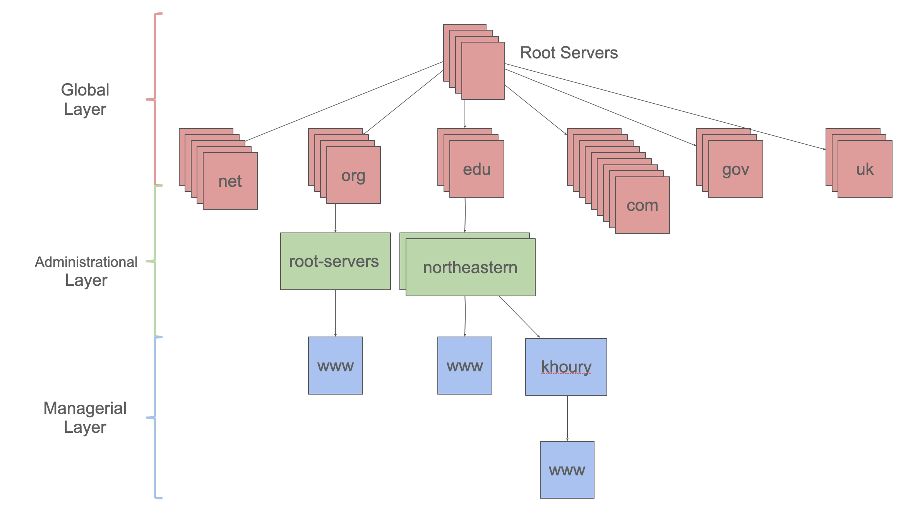
2. Tiered Architectures
Key idea: Partition the system into distinct tiers based on responsibilities
Each tier scales independently of the others - .com need not know about .org
Satisfying a single request may require multiple tiers
DNS is a tiered architecture
Example: scale .com differently from .gov
Notes:
The key idea of a tiered architecture is that the system is arranged in tiers, based on responsibilities.
For example, DNS is a tiered architecture: the servers are arranged in tiers: for example: one for root, one for .edu, one for northeastern.edu, one for khoury.northeastern.edu, one for courses.khoury.northeastern.edu. Each server is responsible for only the addresses that end in its zone. The server for khoury.northeastern.edu is only responsible for *.khoury.northeastern.edu . If you ask it for calendars.registrar.northeastern.edu, it will forward the request to the server for northeastern.edu. That server will forward the request to the server for registrar.northeastern.edu, which presumably can answer the original question. We’ll see more about this later.

Slide 11
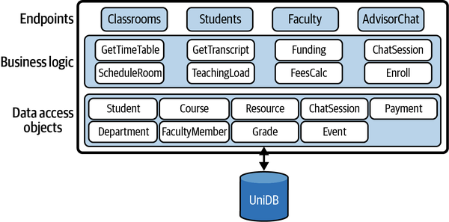
A tiered architecture is like a layered architecture, only distributed
Notes:
Any layered architecture could become a tiered architecture if we need to distribute some of the functions across multiple servers. (Don’t worry, we’re not going to quiz you on the difference between a layered architecture and tiered architecture :smiley)☺

Slide 12
3. Pipeline Architectures
The pieces correspond to stages in the transformation of data in the system
Good for complex straight-line processes where multiple stages applied to different data, concurrently
Each stage in the pipeline takes an input, produces an output: otherwise stateless
Example: Map/Reduce splits data, filters it through stages, then combines
Pipeline architecture allows flexibility in mapping stages to physical servers
Big Data (lots of work)
Partition
Stage 1
Stage 1
Stage 1
Stage 1
Stage 1
Stage 2
Stage 2
Stage 2
Stage 2
Stage 2
Stage 3
Stage 3
Stage 3
Stage 3
Stage 3
Combine
Result
Notes:
<Read slide> note that figure on right is map/reduce architecture, showing pipeline through stages.
Each stage might be on a different server, or they could be on the same. Like tiered or layered architecture, this embraces both distributed and monolithic versions.

Slide 13
Pipeline Architectures
Scalability/Performance:
Add more machines to process more data in parallel
Limited by bandwidth to transfer inputs/outputs between stages
Fault tolerance: Each stage in pipeline is stateless. If one fails, it can be repeated elsewhere.
Big Data (lots of work)
Partition
Stage 1
Stage 1
Stage 1
Stage 1
Stage 1
Stage 2
Stage 2
Stage 2
Stage 2
Stage 2
Stage 3
Stage 3
Stage 3
Stage 3
Stage 3
Combine
Result
Notes:
How does a pipeline architecture address our distributed systems requirements and tradeoffs?
Similarly to the tiered architecture, we can scale to support processing more data concurrently by adding more machines. Each machine can process some number of stages concurrently. Because the stages are independent, we can always add more machines to process more data in parallel.
The limitation that we will run into is the bandwidth to transfer the inputs and outputs from each stage in the pipeline to the next.
However, once we recognize this limitation, we can also design systems around it: consider this exact problem of map/reduce running on a lot of data. How do we move that big amount of data to be in the right spot to run a task on it? Map/Reduce is implemented in conjunction with the Google File System, (GFS): each filter in the pipeline is run on a chunk server that already has that piece of data.
In terms of fault tolerance, the pipeline architecture improves over the general tiered architecture because it also enforces the requirement that each stage in a pipeline is stateless. If a node fails in the middle of processing some data in a stage of the pipeline, the system could always recover by running that same input through the pipeline again: no data would become corrupted by partial results from the failed computation.

Slide 14
4. Microservice Architectures
Organize implementation around components (responsibilities)
Each component is implemented independently
Each component is
independently replaceable,
independently updatable
Components can be built as libraries, but more usually as web services
Services communicate via a well-defined protocol (typically REST/http, though others are possible)
Notes:
(Read slide)

Slide 15
Microservices: Schematic Example
Different languages, different operating systems
NodeJS, MongoDB
Google Service
Java, MySQL
Todos
Logins
Mailer
Mod 1
Mod 2
Mod 3
REST service
REST service
REST service
Productivity App
Database
Database
Database
Frontend
REST
Search Engine
Analytics
Social Crawler
“Dumb”
App Server
Mod 4
Mod 5
Mod 6
REST service
REST service
REST service
Database
Database
Database
Java, Neo4J
C#, SQLServer
Python, MongoDB
Notes:
Here is an example of a micro services architecture for a productivity application. There are multiple components to this application. Each component is shown as a grey box, and is a micro service.
(Note the separation of responsibilities to entirely different services that only connect over a well-defined API)

Slide 16
Microservices are (a) highly scalable and (b) trendy
Microservices at Netflix:
100s of microservices
1000s of daily production changes
10,000s of instances
BUT:
only 10s of operations engineers
https://medium.com/refraction-tech-everything/how-netflix-works-the-hugely-simplified-complex-stuff-that-happens-every-time-you-hit-play-3a40c9be254b

Slide 17
Microservice Advantages and Disadvantages
Advantages
services may scale differently, so can be implemented on hardware and software appropriate for each
services are independent (yay for interfaces!) so can be developed and deployed independently
Disadvantages
Shared data?
Requires high availability
Service discovery?
Data consistency?
Overall system complexity
Notes:
The advantages of microservice architectures are clear: the independent services may scale differently, so they can be built on different hardware and software platforms. Furthermore, they have independent specifications, so they can (in principle) be built independently.
On the other hand, there are limitations in practice—
What do we do about data that needs to be shared across the different services?
Services may depend on each other in complex and unpredictable ways. What happens if a service goes down? This decreases the effective redundancy.
Consistency is harder: you may want data to be consistent across multiple servers.

Slide 18
Microservices vs Monoliths
higher is better
https://martinfowler.com/microservices/
Notes:
Microservice advocates claim that as the system grows in complexity, the micro service abstraction provides gains in understanding and productivity that outweigh the cost of the added complexity.
It would be interesting to have some hard data about this, but companies probably don’t want to be too transparent about stuff like this.

Slide 19
Learning Goals for this Lesson
You should now be able to
Recognize a few common software architectures
Discuss some of the tradeoffs of scalability, performance, and fault tolerance between these architectures

